Slide 1


RPA Essential Training Nanyang Polytechnic School of Information Technology

Slide 2

ConfigFile, Nested loops and File Extensions
Introduction to ConfigFile
Loop Through dataTable
Check data and write to DataTable

Slide 3
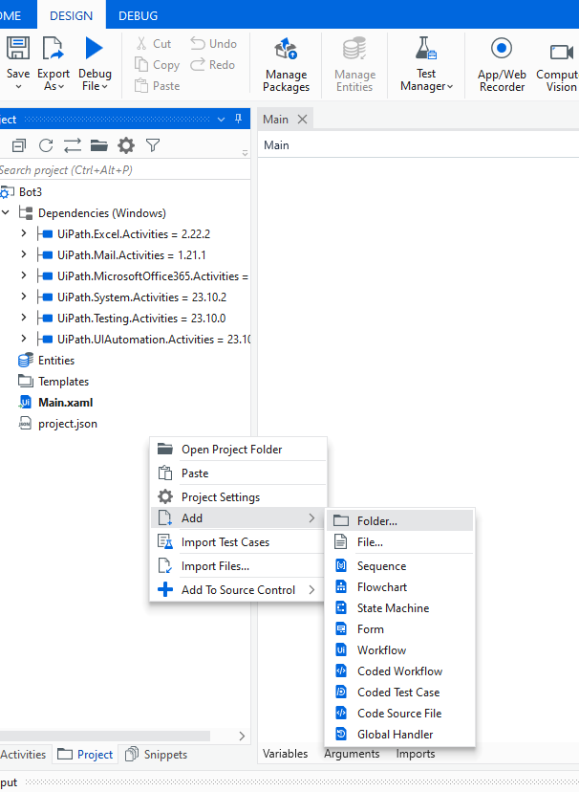
ConfigFile
ConfigFile are usually created as a document together with the solution.
First create a folder call data
Notes:
In UiPath Studio, Data Table is a prototype of spreadsheet data that represents the row and column without any headers. The Excel application is a package that enables the excel activities with whole work. Apart from this, it specifies the .xlsx file where you want to work.
You can start with the data table, if you don't have MS office on your laptop, desktop. The Container properties of the data table make Excel application activity for each process such as Read Range, Append Range, Read cell, Write range, Sort Table. Along with these, other types of data table activities that can be done are: Get row item, Build data table, Data Table, For Each Row and Add data row.

Slide 4
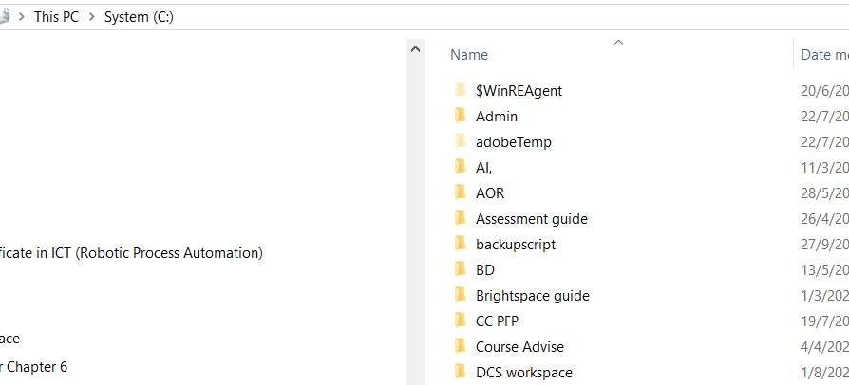
ConfigFile
ConfigFile are usually created as a document together with the solution.
Download the above file into c:\ and unzip to
C:\DCSworkspace
Notes:
In UiPath Studio, Data Table is a prototype of spreadsheet data that represents the row and column without any headers. The Excel application is a package that enables the excel activities with whole work. Apart from this, it specifies the .xlsx file where you want to work.
You can start with the data table, if you don't have MS office on your laptop, desktop. The Container properties of the data table make Excel application activity for each process such as Read Range, Append Range, Read cell, Write range, Sort Table. Along with these, other types of data table activities that can be done are: Get row item, Build data table, Data Table, For Each Row and Add data row.

Slide 5
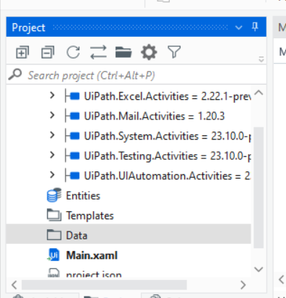
ConfigFile
ConfigFile are usually created as a document together with the solution.
Drag the file, “ConfigFile.xlsx” into the folder
Notes:
In UiPath Studio, Data Table is a prototype of spreadsheet data that represents the row and column without any headers. The Excel application is a package that enables the excel activities with whole work. Apart from this, it specifies the .xlsx file where you want to work.
You can start with the data table, if you don't have MS office on your laptop, desktop. The Container properties of the data table make Excel application activity for each process such as Read Range, Append Range, Read cell, Write range, Sort Table. Along with these, other types of data table activities that can be done are: Get row item, Build data table, Data Table, For Each Row and Add data row.

Slide 6
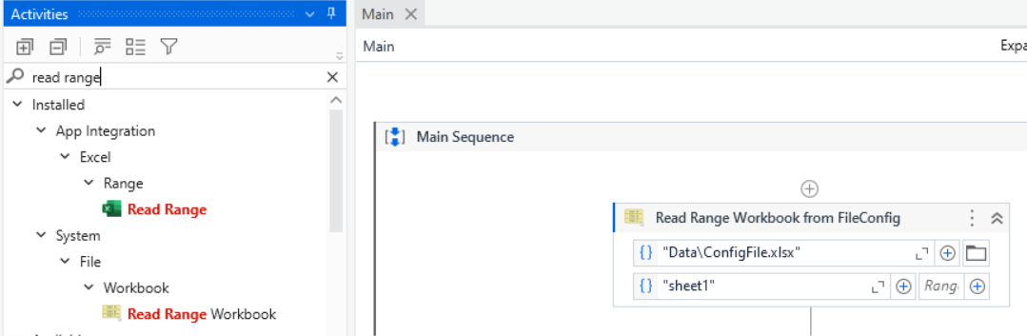
Read Range
For Each in Datatable
Write to DataTable
Search for the read range and use the read range workbook activity
Since the file is in the data, you can point it to “Data\ConfigFile”

Slide 7
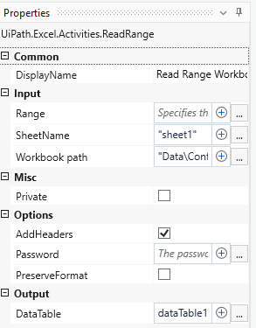
Read Range
For Each in Datatable
Write to DataTable
Click on the dataTable. Press keystroke “control” + “k” then type in dataTable1

Slide 8
ConfigFile, Nested loops and File Extensions
Introduction to ConfigFile
Loop through dataTable
Check data and write to DataTable

Slide 9
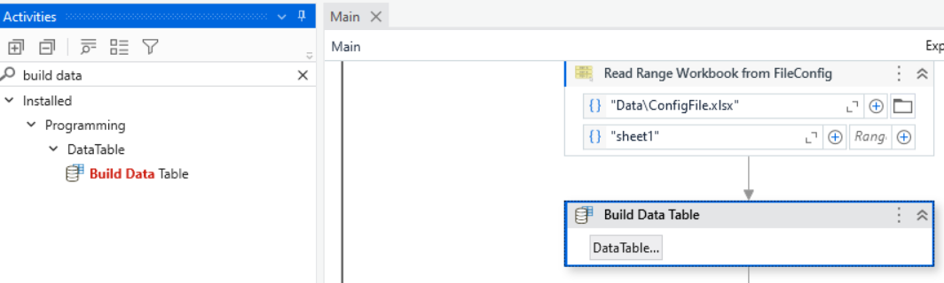
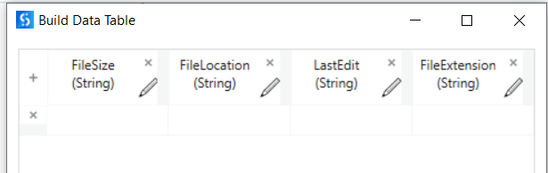
Use the activity build data table and double click on the dataTable button above
Create the dataTable as shown with all strings by clicking on the “+” sign

Slide 10
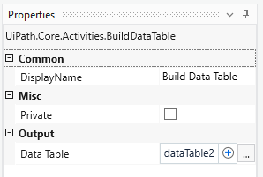
Click on the dataTable. Press keystroke “control” + “k” then type in dataTable2
Check that the dataTable2 is in the variables panel

Slide 11
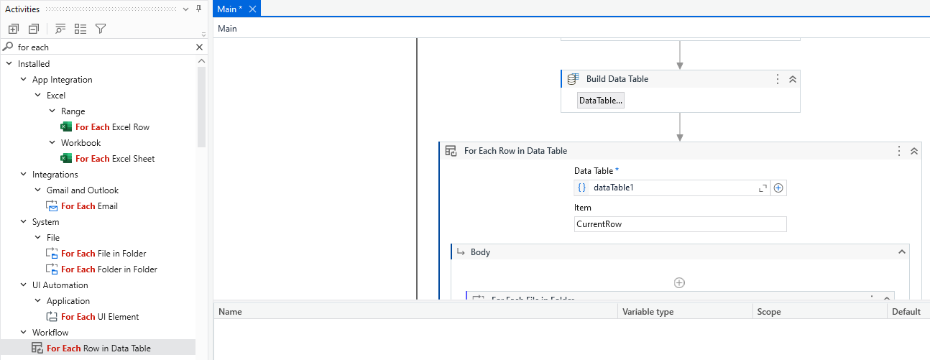
Use the activity “For Each Row in DataTable” and loop through the items in dataTable1

Slide 12
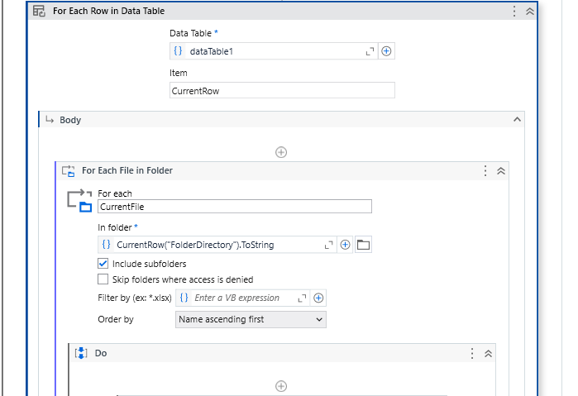
Loop within a loop
Use the activity “For Each in Folder” in the body of the for loop of DataTable

Slide 13
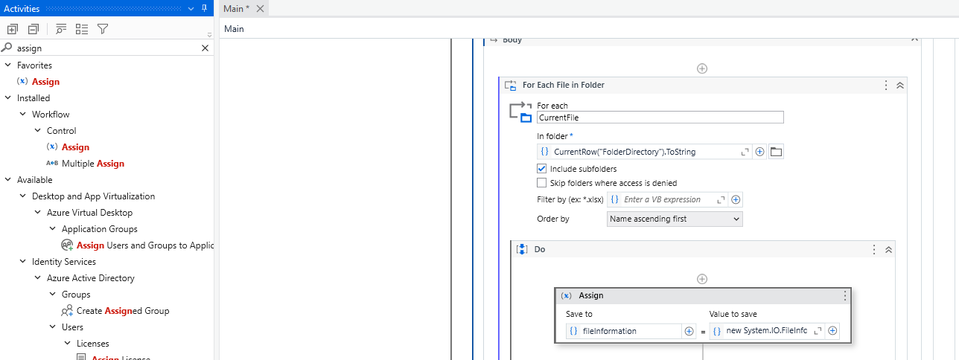
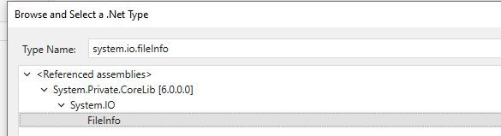
1) Find and use the assign activity and put in the inner for loop
5) type
“new System.IO.FileInfo(CurrentFile.Tostring)”
For the “Value to save” excluding the quotation marks
2) Click on the left-hand side text box. Press keystroke “control” + “k” then type in fileInformation
4) Search for the type “system.io.fileInfo and select fileInfo as shown below
3) Go to the variable panel and click on the variable type and choose browse for types. Then type “system.io.fileInfo

Slide 14
ConfigFile, Nested loops and File Extensions
Introduction to ConfigFile
Reading excel files
Check data and write to DataTable

Slide 15
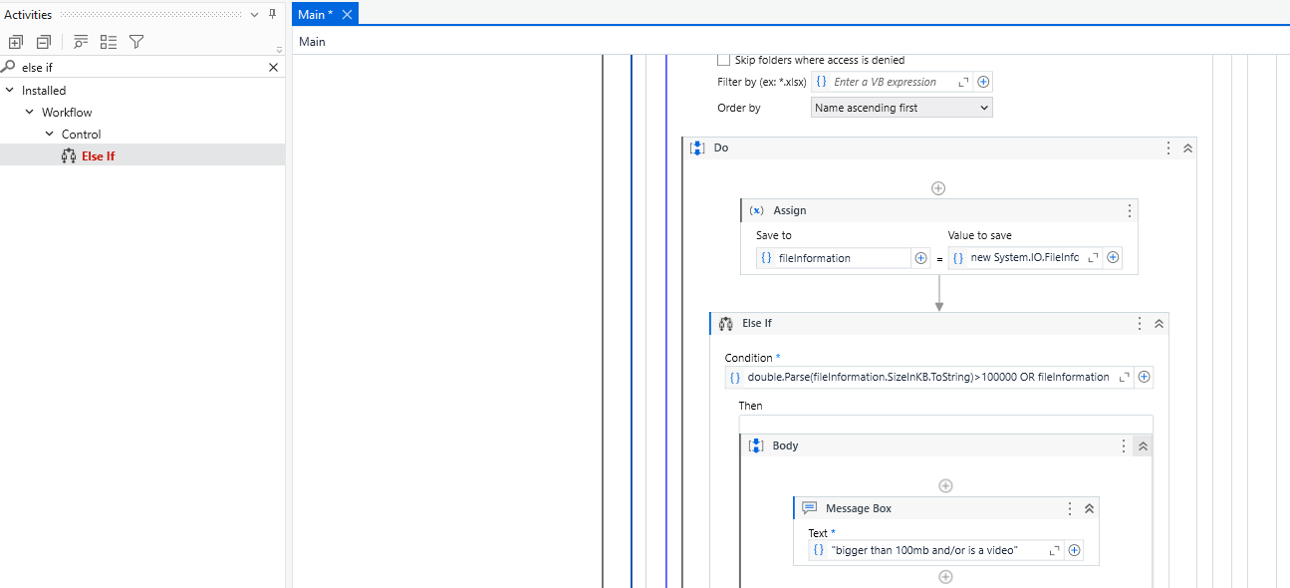
Use the activity “else if” and type in
double.Parse(fileInformation.SizeInKB.ToString)>100000 OR fileInformation.Extension =".mp4"

Slide 16
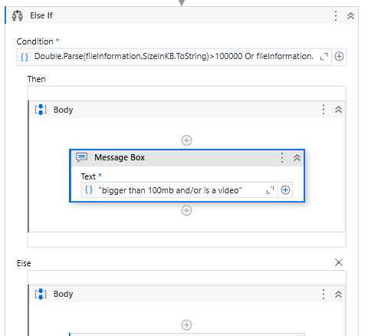
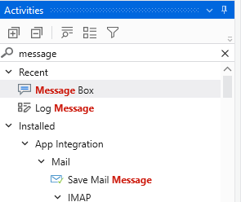
Use the activity “Message Box” and type in the “Then body” of the else if condition
"bigger than 100mb and/or is a video"

Slide 17
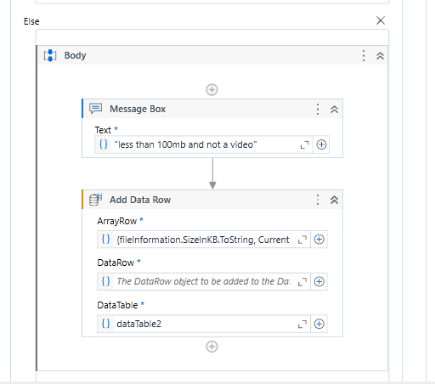
Use the activity “Message Box” and type in type in the “Else body” of the else if condition
"less than 100mb and not a video"
Use the activity “Add Data Row” and type in Arrow Row
{fileInformation.SizeInKB.ToString, CurrentFile.ToString, fileInformation.LastWriteTime.ToString, fileInformation.Extension}
These provide the filesize, fileDirectory, last write time and the extension of each record found in the folder crawled by the bot in
C:\DCS workspace\NYC-Core Business and C:\DCS workspace\NYC-Corporate support

Slide 18
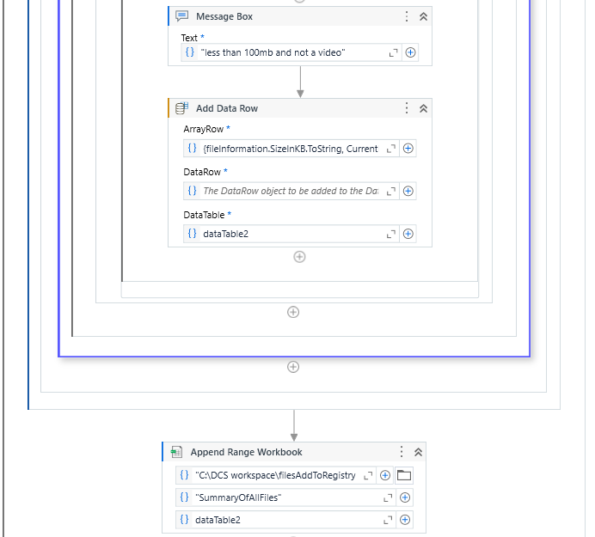
Wrap up with the activity “Append Range Workbook” outside of the For each row in dataTable
Type in the following info.
"C:\DCS workspace\filesAddToRegistry.xlsx"
"SummaryOfAllFiles“
dataTable2

